Slide 1
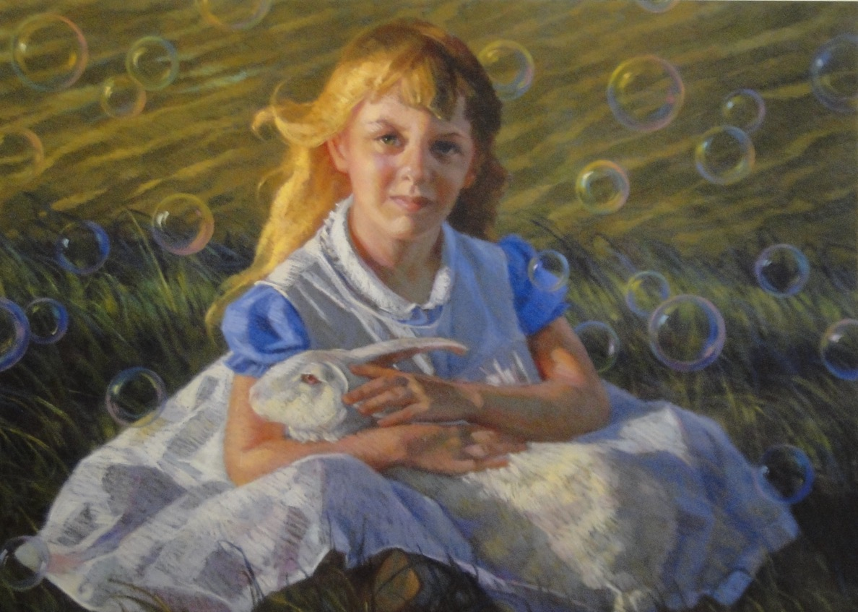
Week 3 – Drawing, Painting, Printing, Photography, and Film
ARTS 1301 Art Appreciation

Slide 2
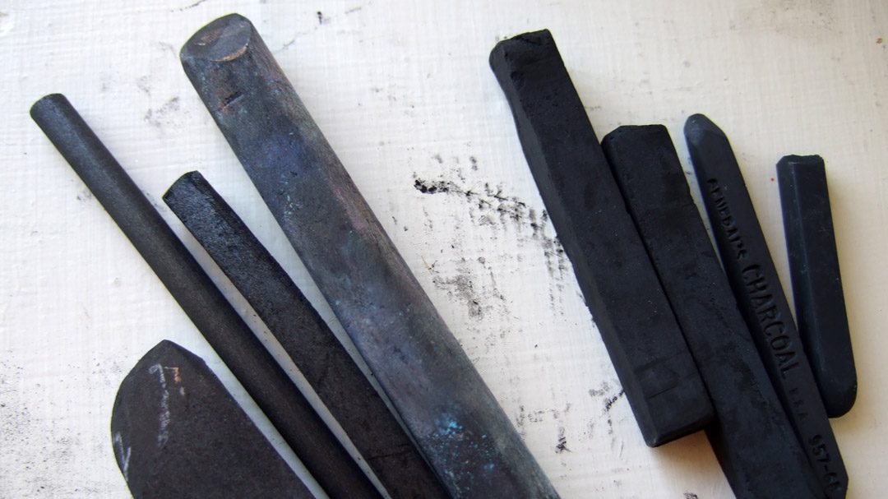
CHARCOAL drawing
Charcoal is made by slowly oxidizing wood and vines down to their carbon substance. Charcoal goes on easily, blends well, and makes grays and blacks.

Slide 3
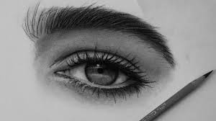
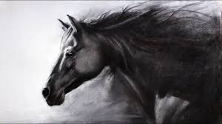

Slide 4
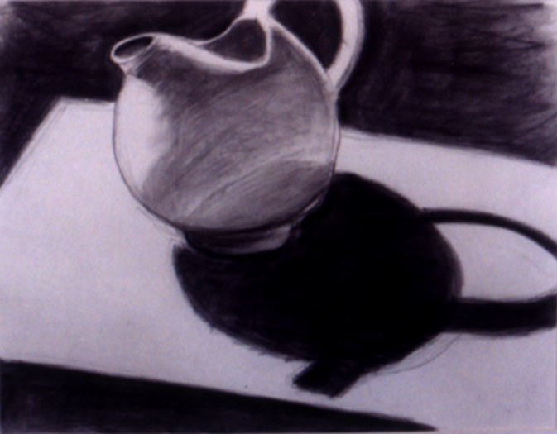

Slide 5
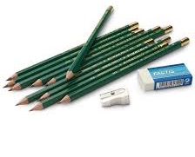
GRAPHITE drawing
Graphite is a carbonite mineral that is mined and then powdered. It is then recompressed with varying degrees of hardness and softness. “B” (black) and ebony graphite drawing tools are soft and make dark marks in grays but not quite black. “H” (hard) compressed graphites are hard and make thin and light marks.

Slide 6
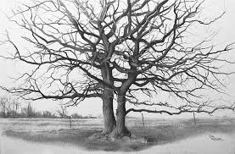
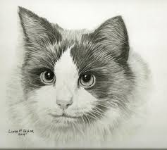

Slide 7
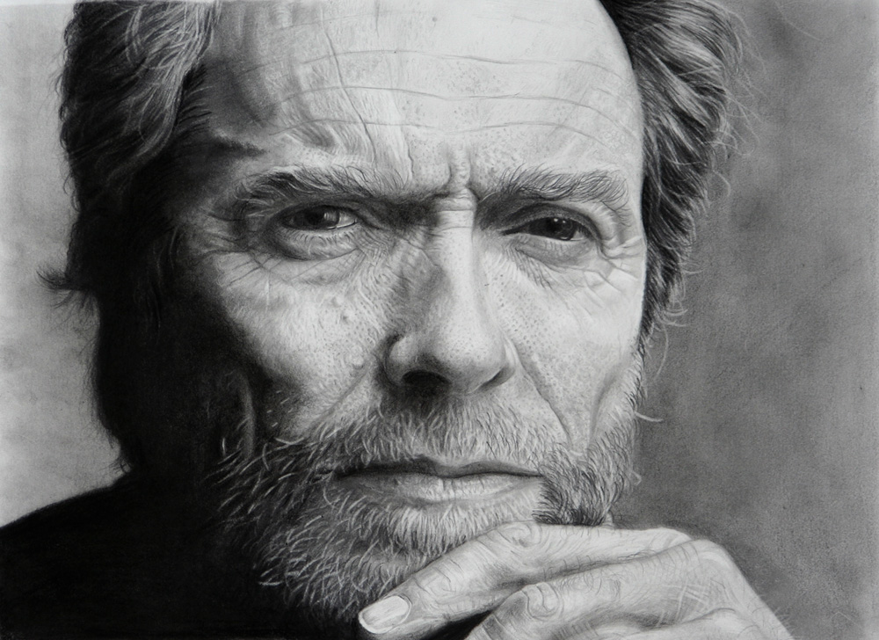

Slide 8
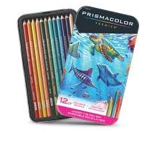
COLOR PENCIL drawing
Professional color pencils are made with quality pigments mixed with bee’s wax. Often called by a brand name such as Prismacolor. The so called map colors have very little pigment color and are not used professionally.

Slide 9
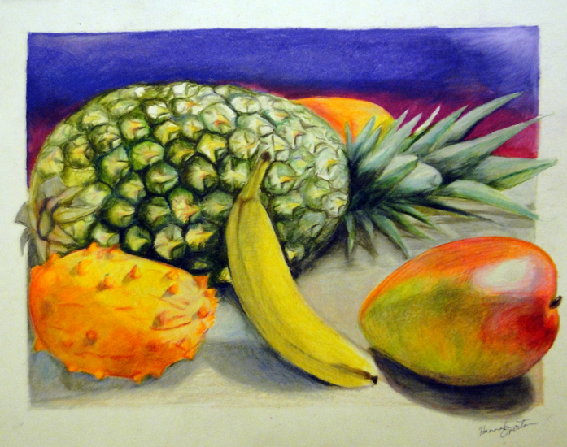
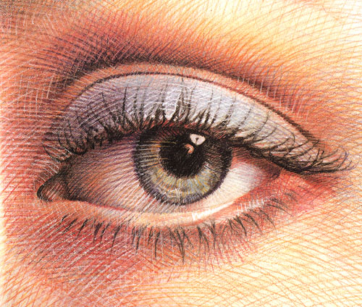

Slide 10
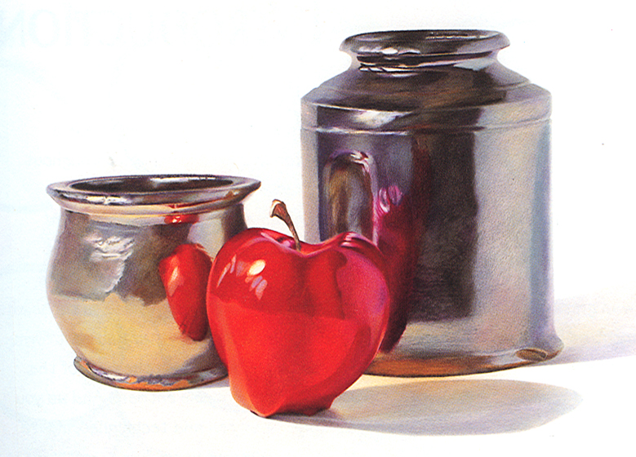

Slide 11
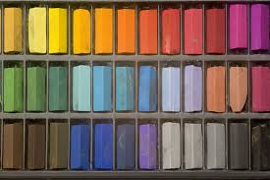
PASTEL drawing
Made with pure pigments and compressed into sticks or made into pencils. Usually very soft. Pastels blend very well and require a rough surface paper for the pigment to stay.

Slide 12
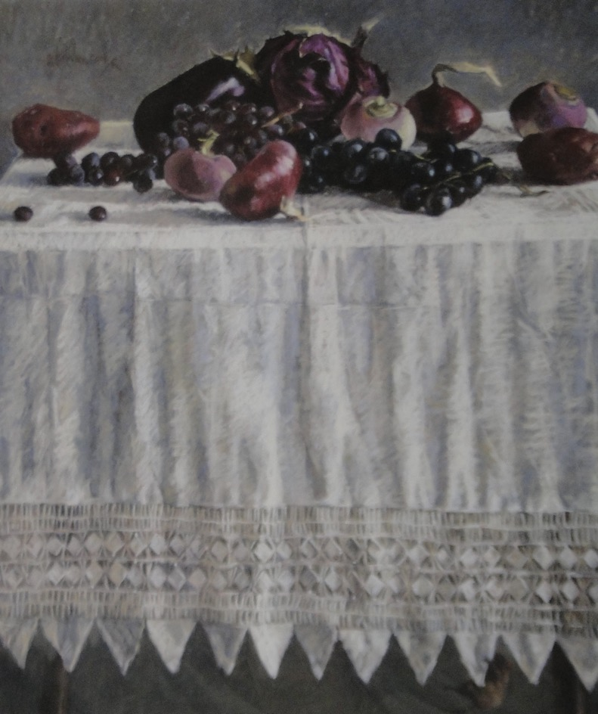

Slide 14
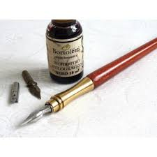
INK drawing
Drawing ink is made with finely powdered carbon in a suspension of distilled water. The black ink can be drawn with a pen or diluted with water and painted as various grays with a brush. There are color inks that use dyes.

Slide 15
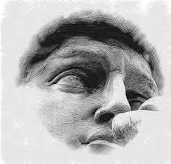
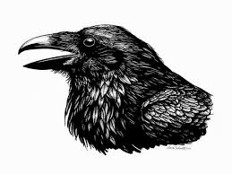

Slide 16
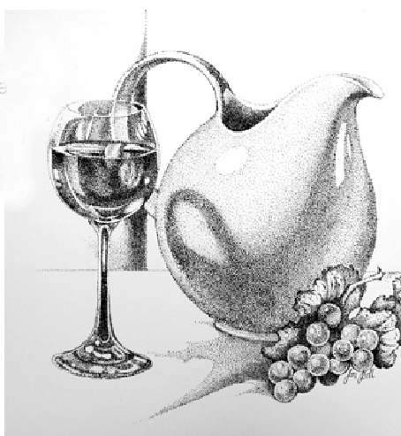
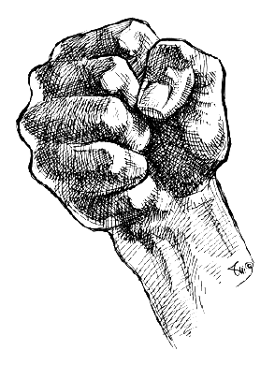

Slide 17
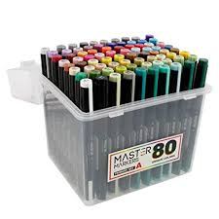
MARKER drawing
Markers are made with dyes suspended in an alcohol medium. Unlike pigment, dyes will fade in ultraviolet light. Markers come in pens, wide and narrow. The professional designer markers are available particularly in light values, that can be layered to make darker values. Used primarily for fast illustrating. Brand names include
Chartpak markers
and Prismacolor.

Slide 18
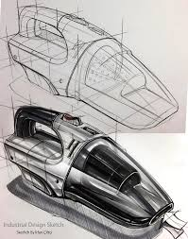
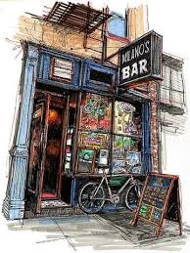
MARKER drawing

Slide 19
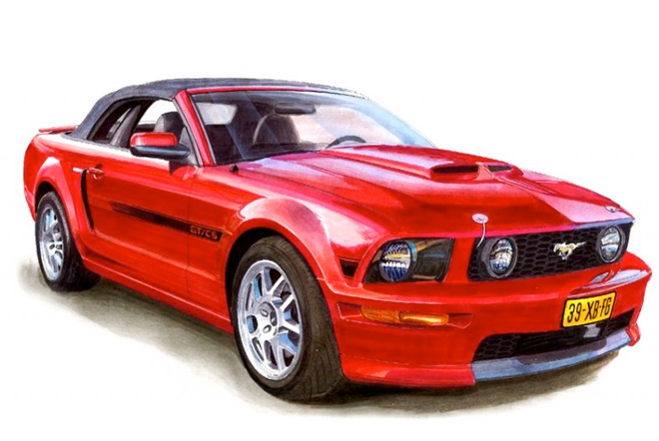

Slide 20
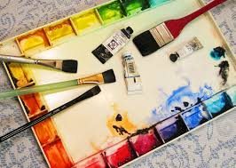
WATERCOLOR painting
Made with pigments, gum Arabic as a binder, and water. Usually purchased in tubes, but also available in “pans” Watercolors are painted in transparent washes on high quality paper with high quality brushes. Watercolors dry quickly and can be remoistened. Frame under glass.

Slide 21
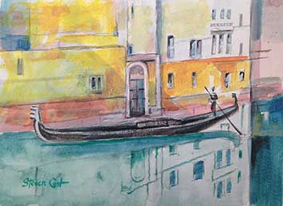
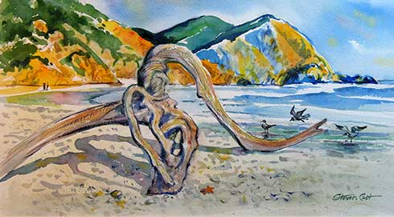
WATERCOLOR painting

Slide 22
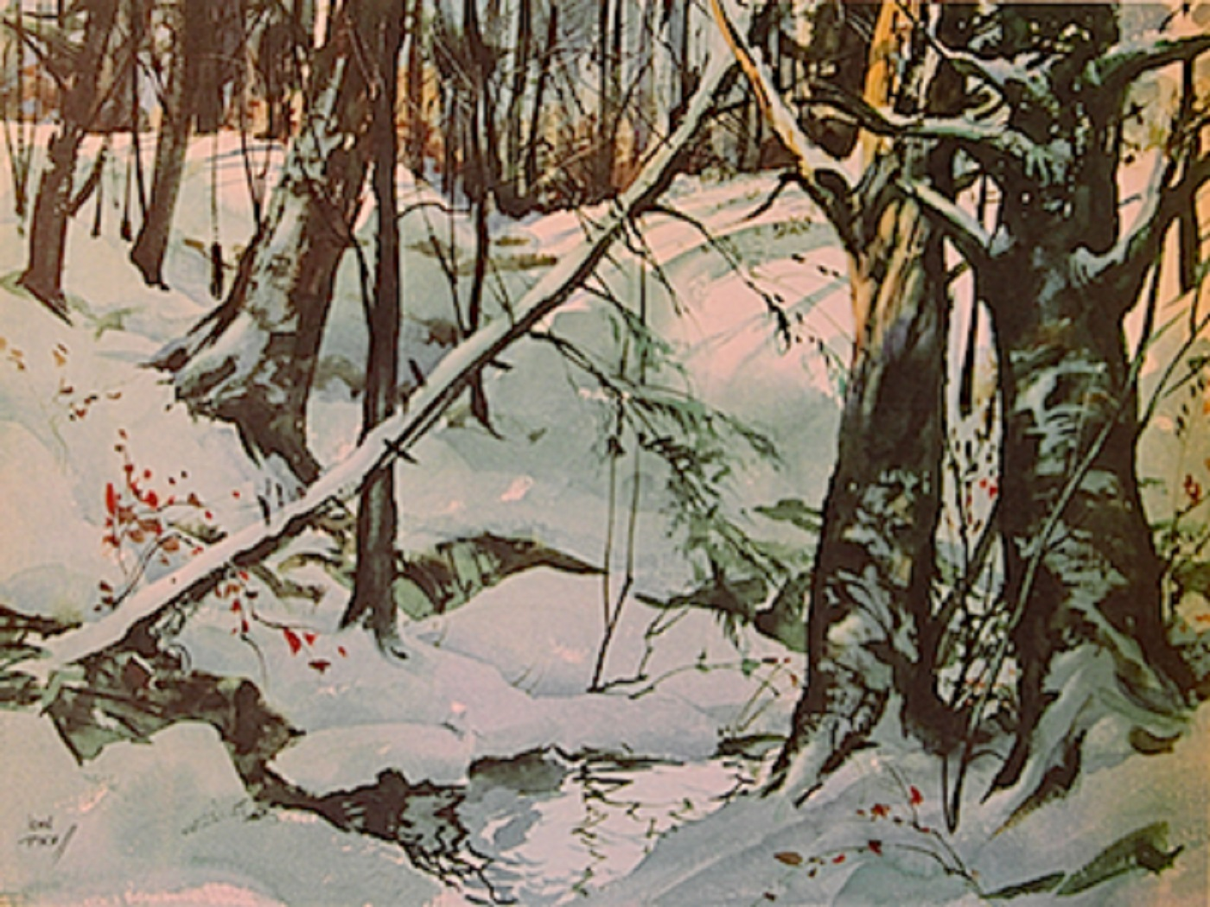

Slide 23
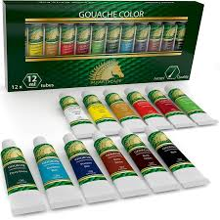
GOUACHE painting
Made with opaque pigments, gum Arabic as a binder, and water. Differs from transparent watercolor since gouche is opaque. Usually purchased in tubes and are painted on high quality paper. They dry quickly and can be redisolved.

Slide 24
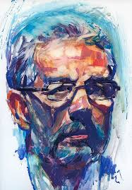
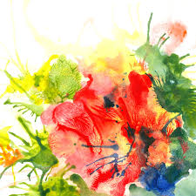

Slide 25
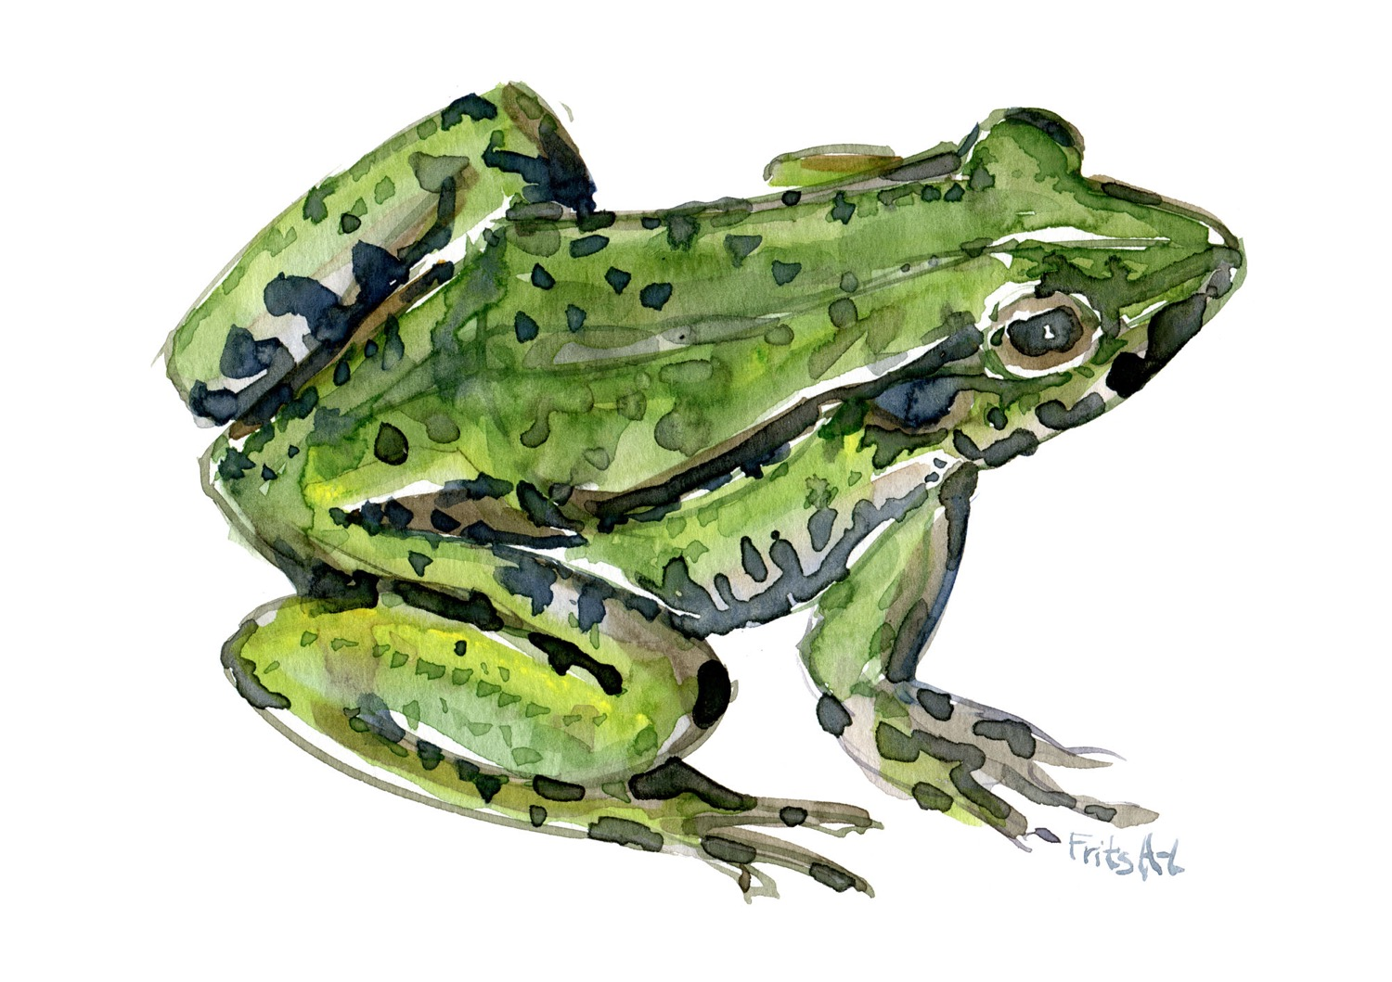

Slide 26
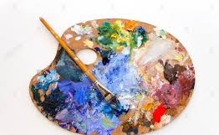
ACRYLIC painting
Made with pigments mixed in a polymer plasic base. Cleans up with water. Dry quickly. They made be used like oils or watercolors. Dry permanently. Can be applied to paper or canvas and many other surfaces.

Slide 27
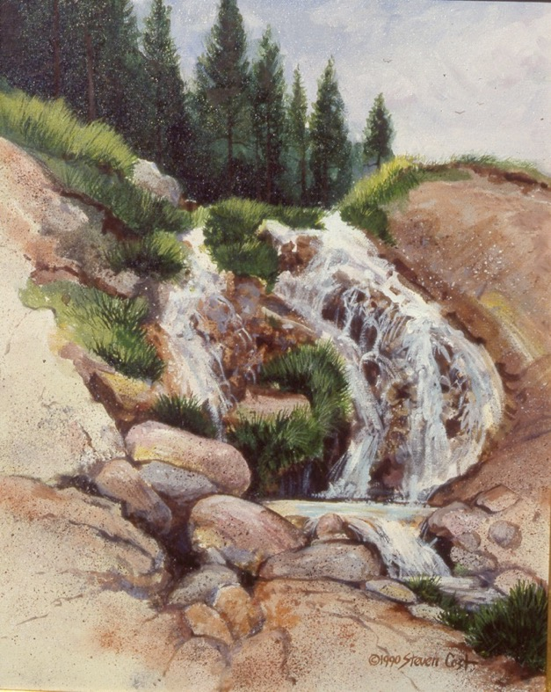
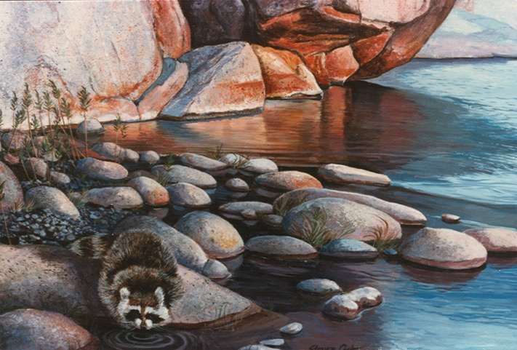
ACRYLIC painting

Slide 29
OIL painting
Made with pigments mixed with an organic oil such as flax seed oil or linseed oil. Dries slowly for better blending such as portrait painting. Can be painted on wood panel or canvas.

Slide 30
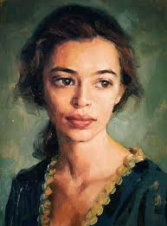
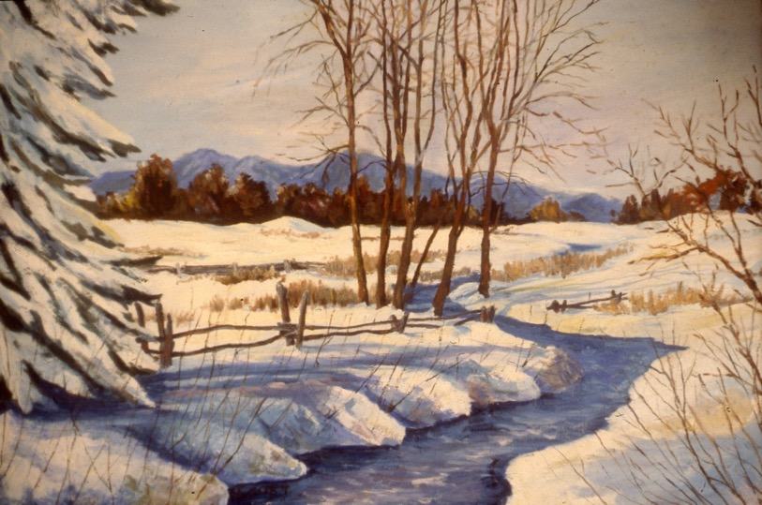

Slide 31
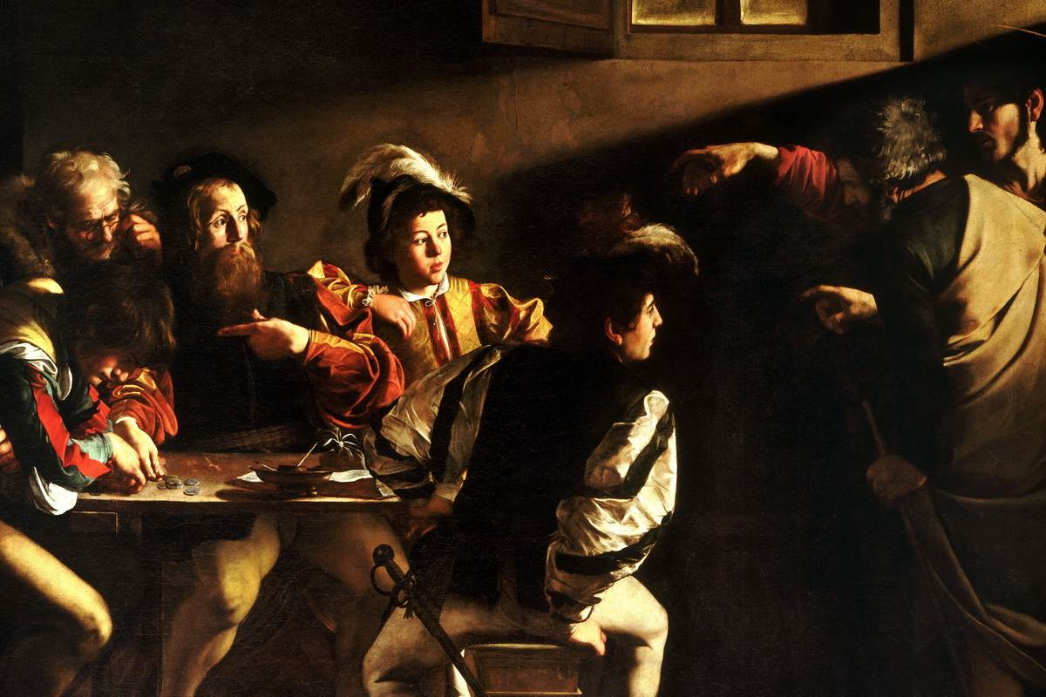

Slide 32
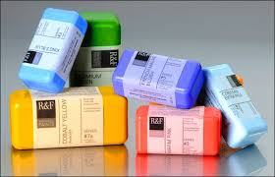
ENCAUSTIC painting
Made with pigments mixed with hot bee’s wax. Encaustic is usually painted on wood. The wax in it seals the wood, and preserves the painting. Egyptians and Romans used encaustic extensively a couple thousand years ago and the art looks like new today.

Slide 33
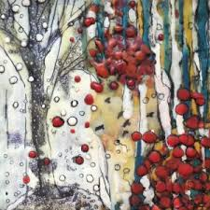
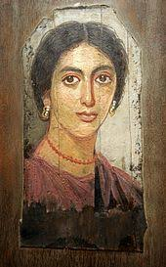
ENCAUSTIC painting

Slide 34
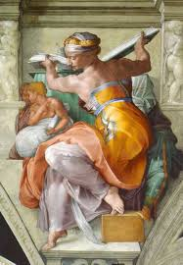
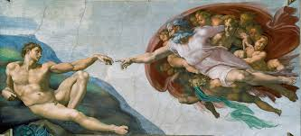
FRESCO painting
Painting tempera pigments directly into fresh plaster. Very popular during the Renaissance, but rarely used today.

Slide 35
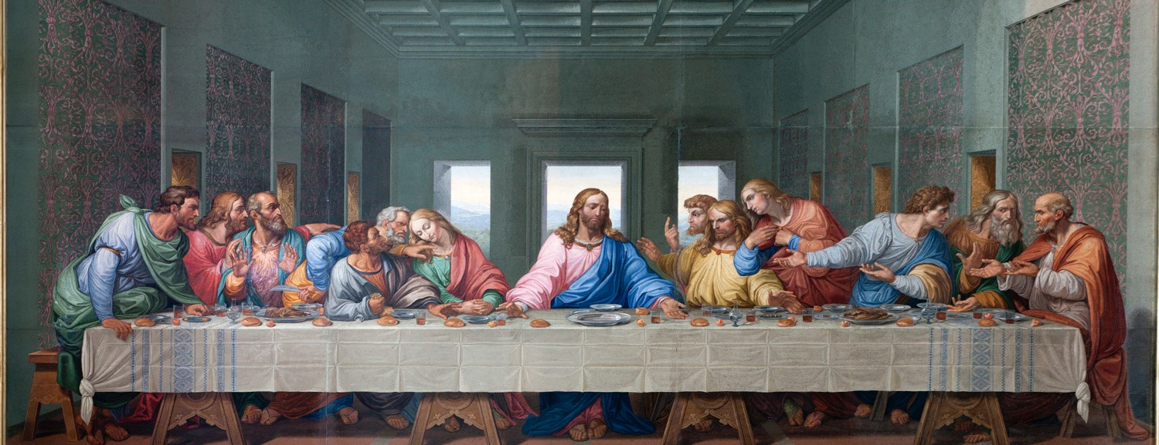

Slide 36
SURFACES

Slide 37
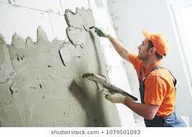
PLASTER
Plaster is a pasty composition (as of lime or gypsum, water, and sand) that hardens on drying and is used for coating walls, ceilings, and partitions. Plastering is one of the most ancient building techniques.

Slide 38
PAPER
Artist papers may be handmade, or manufactured. Most handmade papers are formed with pulped cotton fibers and are preferred for watercolor painting. Manufactured paper, the kind used in books, is generally made of wood pulp. Paper was invented in China, Europeans were still drawing, lettering, and painting of thin animal skins, the sheets of which are called vellum. After secret of papermaking reached Europe, European countries have been making the best paper available.

Slide 39
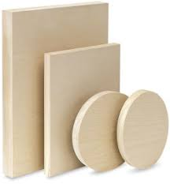
WOOD PANEL
For centuries artists painted frescos or on thin wood panels similar to veneer. The wood is often first primed with gesso — an opaque white paint-like medium containing some gypsum for opacity.

Slide 40
CANVAS
For centuries artists on wood panels. The damp climate around the lagoon and canals of Venice, Italy caused the paints to dry too slowly and large paintings needed a less expensive surface. Since the Venicians were a seafaring city, large cotton sail cloth was readily at hand. The northern Europeans particularly liked painting oils on canvas. Canvas must be stretched on wood frames and treated with gesso before painting.

Slide 41
A PRINT is an image or design printed from an engraved plate, wooden block, or similar surface. There are five basic processes of printmaking:
PRINTMAKING
Relief Intaglio Lithography Silkscreen Monotype

Slide 42
The printing process results in an IMPRESSION For example, if an image that has been transferred through pressure onto paper from a MATRIX, the surface upon which the design has been created. A single matrix can be used to make many virtually identical impressions. Taken together, these multiple impressions, made on paper from the same matrix, are called an EDITION.

Slide 43
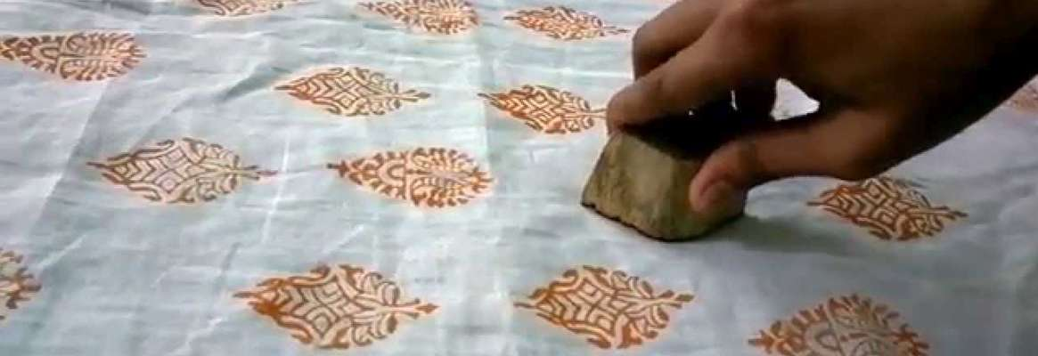
ORIGINAL PRINT As collectors have come to value prints more and more highly, the somewhat confusing concept of the ORIGINAL PRINT has come into being. How, one wonders, can an image that exists in multiple be considered “original”? By and large, an original print can be distinguished from the reproductive print—one printed mechanically—by the fact that it has been printed by the artist or under the artist’s supervision.

Slide 44
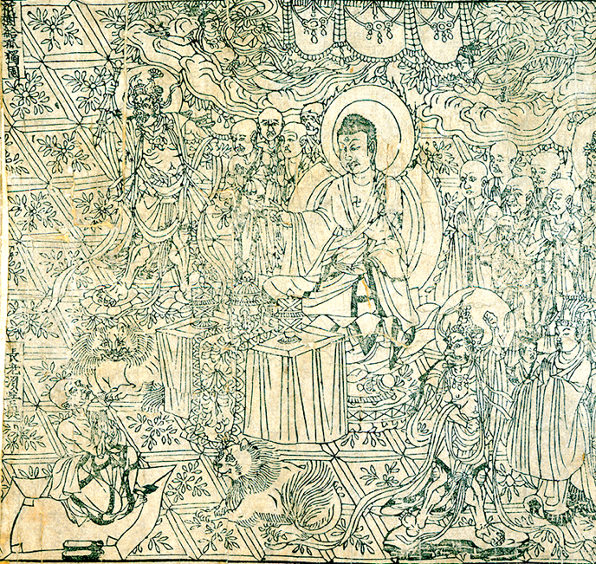
The medium of printmaking appears to have originated in China in the ninth century ce with the publication of the world’s earliest known printed book, the DIAMOND SUTRA, one of Buddhism’s more important texts.
Wood block print. Frontispiece, Diamond Sutra, from Cave 17, Dunhuang, printed in the ninth year of the Xiantong Era of the Tang dynasty, 868 CE

Slide 45
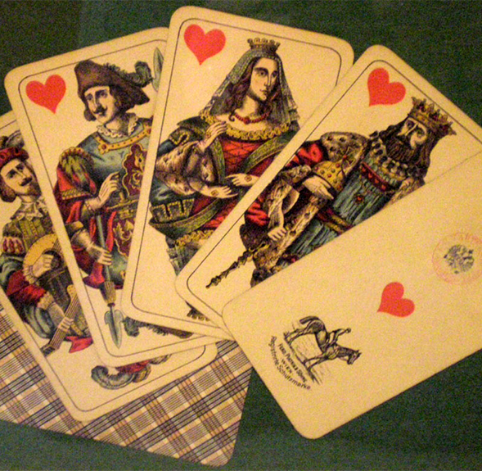
Playing Cards Among the earliest paper prints to receive widespread distribution across Europe, among even the illiterate, were playing cards, the designs of which have changed little since late medieval times.

Slide 46
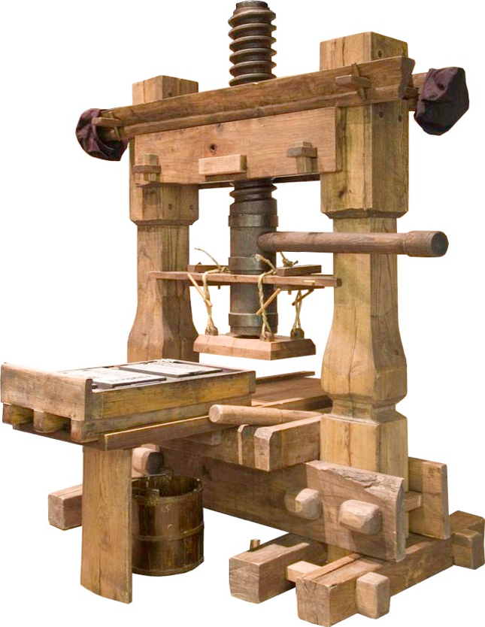
Gutenberg Printing Press In 1455, Gutenberg published his first major work, the Forty-Two-Line Bible (Fig. 10-3)—so named because each column of type contains 42 lines—the first substantial book to be published from movable type in Europe. CLICK on image for Gutenberg Printing Press Video

Slide 47
The earliest prints, such as the illustrations for the Diamond Sutra and The Nuremberg Chronicle, were WOODCUTS, a kind of RELIEF printing. The process for making woodcuts has remained fundamentally the same over the centuries.

Slide 48
RELIEF PRINTING The term RELIEF refers to any printmaking process in which the image to be printed is raised off the background in reverse. Common rubber stamps use the relief process. All relief processes rely on this basic principle, even though the printing may be done on a printing press. Preparing woodcuts or linocuts, the background is cut awau leaving the raised flat surface that received the ink for printing. Linocut video Woodcuts video

Slide 49
INTAGLIO PRINTING With the intaglio process, on the other hand, the areas to be printed are below the surface of the plate. Intaglio is the Italian word for “engraving,” and the method itself was derived from engraving techniques practiced by goldsmiths and armorers in the Middle Ages. In general, intaglio refers to any process in which the cut or incised lines on the plate are filled with ink. Intaglio video

Slide 50
INTAGLIO PRINTING

Slide 51
LITHOGRAPHY PRINTING Lithography—meaning, literally, “stone writing”—is the chief planographic printmaking process, meaning that the printing surface is flat. There is no raised or depressed surface on the plate to hold ink. Rather, the method depends on the fact that grease and water don’t mix.. Lithography video

Slide 52
SERIGRAPHY OR SCREEN PRINTING Silkscreens are more formally known as serigraphs, from the Greek graphos, “to write,” and the Latin seri, “silk.” Unlike other printmaking media, no expensive, heavy machinery is needed to make a serigraph. A stencil process, one can print on almost any surface Serigraphy video

Slide 53
SERIGRAPHY OR SCREEN PRINTING

Slide 54
MONOPRINT PRINTING A kind of printmaking to consider, one that has much in common with painting and drawing. However, monotypes are generally classified as a kind of printmaking because they use both a plate and a press in the making of the image. Unlike other prints, however, a monotype is a unique image. Once it is printed, it can never be printed again. In monotypes, the artist forms an image on a plate with printer’s ink or paints, and the image is transferred to paper under pressure, usually by means of an etching press. Monoprint Video

Slide 55
MONOPRINT PRINTING (continued) Part of the difficulty and challenge of the process is that if a top layer of paint is applied over a bottom layer of paint on the plate, when printed, the original bottom layer will be the top layer and vice versa. Thus, the foreground elements of a composition must be painted first on the plate, and the background elements over them. The process requires considerable planning.

Slide 56
Photography and Time-base Media

Slide 57
Photography and Time-base Media Photography began, in about 1838, with still images, but the still image almost immediately generated the thought that it might be possible to capture the object in motion as well. To the silent moving image, sound was soon added. To the “talkie” was added color. And film developed in its audience a taste for “live” action, a taste satisfied by live television transmission, video images that allow us to view anything happening in the world as it happens.

Slide 58
Photography and Time-base Media Photography (from the Greek phos, “light,” and graphos, “writing,” literally “writing with light”) is, like collage, at least potentially an inclusive rather than an exclusive medium. You can photograph anything you can see. As one historian of American photography has put it: “The world is essentially a storehouse of visual information.”

Slide 59
Such a dream seemed even more possible when photographs of a horse trotting were published by Eadweard Muybridge in La Nature in 1878 (Fig. 11-2). Muybridge had used a trip-wire device in an experiment commissioned by California governor Leland Stanford to settle a bet about whether there were moments in the stride of a trotting or galloping horse when it was entirely free of the ground.

Slide 60
Camera Obscura Camera is the Latin word for “room.” And, in fact, by the sixteenth century, a darkened room, called a camera obscura, was routinely used by artists to copy nature accurately. The scientific principle employed is essentially the same as that used by the camera today. A small hole on the side of a light-tight room admits a ray of light that projects a scene, upside down, directly across from the hole onto a white wall.

Slide 61
Daguerreotype In England, William Henry Fox Talbot presented a process for fixing negative images on paper coated with light-sensitive chemicals, a process that he called ­photogenic drawing. In France, a different process, which yielded a positive image on a polished metal plate, was named the daguerreotype, after one of its two inventors, Louis-Jacques-Mandé Daguerre (Nicéphore Niépce had died in 1833, leaving Daguerre to perfect the process and garner the laurels). Public reaction was wildly enthusiastic, and the French and English press faithfully reported every development in the greatest detail.

Slide 62
In 1843, Talbot made a picture, which he called The Open Door, that convinced him that the calotype could not only document the world as we know it, but also become a work of art in its own right. When he published the image in his book The Pencil of Nature, the first book of photographs ever produced, he captioned it as follows: “A painter’s eye will often be arrested where ordinary people see nothing remarkable. A casual gleam of sunshine, or a shadow thrown across his path, a time-withered oak, or a moss-covered stone may awaken a train of thoughts and feelings, and picturesque imaginings.” For Talbot, at least, painters and photographers saw the world as one. What is Photography as Art? Video

Slide 63
Spatial Relations One of the greatest sources of photography’s hold on the popular imagination lies in this ability to aestheticize the everyday—to reveal as beautiful that which we normally take for granted. When he shot his groundbreaking photograph The Steerage. in 1907, American photographer Alfred Stieglitz was transfixed not by the literal figures and objects in his viewfinder, but by the spatial relations. .

Slide 64
Zone System For many photographers, the real art of photography takes place not behind the viewfinder but in the darkroom. Among the masters of darkroom techniques was Ansel Adams who, with colleague Fred Archer, developed the Zone System in the late 1930s. Ansel Adams defined the Zone System as “a framework for understanding exposures and development, and visualizing their effect in advance.

Slide 65
Gray Scale A zone represents the relation of the image’s (or a portion of the image’s) brightness to the value or tone that the photographer wishes it to appear in the final print. Thus each picture is broken up into zones ranging from black to white with nine shades of gray in between—a photographic gray scale. Over the course of his career, Adams became adept at anticipating the zonal relationships that he desired in the final print, even as he was first exposing his negatives to light. As a result, just in setting his camera’s aperture—the size of the opening of the lens—he could go a long way toward establishing the luminescence of the scene that he wanted. Ansel Adams Video.

Slide 66
Dodging and Burning Ansel Adams called this a process of “visualization,” a process never fully completed until he was working in the darkroom. He often spent hours and hours in the darkroom creating the image that he felt represented his initial visualization. There, he employed the techniques of dodging and burning to attain the finish he desired. Dodging decreases the exposure of selected areas of the print that the photographer wishes to be lighter; burning increases the exposure to areas of the print that should be darker. To dodge an area of a print, he might hold a piece of cardboard over it. To burn an area, he might hold a thick piece of paper with a hole cut out of it over the area that he wished to darken. Dodging and Burning Video

Slide 67
The first great master of editing was D. W. Griffith who, in The Birth of a Nation, essentially invented the standard vocabulary of filmmaking. Griffith sought to create visual variety in the film by alternating between and among a repertoire of shots, each one a continuous sequence of film frames.
Film Making

Slide 68
A full shot shows the actor from head to toe, a medium shot from the waist up, a close-up the head and shoulders, and an extreme close-up a portion of the face. The image of the battle scene reproduced here is a long or far shot — a shot that takes in a wide expanse and many characters at once. Griffith makes use of another of his techniques in this shot as well—the frame slowly opens in a widening circle as a scene begins or slowly blacks out in a shrinking circle to end a scene. This is called an iris shot.

Slide 69
Shooting Related to the long shot is the pan, a name given to the panoramic vista, in which the camera moves across the scene from one side to the other. Griffith also invented the traveling or tracking shot, in which the camera, mounted and moved on tracks, moves parallel to the action. In editing, Griffith combined these various shots in order to tell his story.

Slide 70
Camera movement shots
Cinema Movement Shots

Slide 71
Dolly Shot
Click to see video of dolly shot from The Shining

Slide 72
Trucking shot

Slide 73
Trucking shot
Click to see video of trucking shot from The Magnificent Seven

Slide 74
Pan shot
Click to see video of pan shots

Slide 75
Cinema Distance Shots Establishing with Extreme Far shot

Slide 76
Far shot

Slide 77
Full shot

Slide 78
Medium shot

Slide 79
Close-up shot

Slide 80
Extreme Close-up shot

Slide 81
Low shot

Slide 82
High shot

Slide 83
Over-the-Shoulder shot

Slide 84
Assembling a film, the process of editing, is a sort of linear collage, as Léger plainly shows. Although the movies may seem true to life, as if they were occurring in real time and space, this effect is only an illusion accomplished by means of editing. It is perhaps not coincidental that, as film began to come into its own in the second decade of the twentieth century, collage, constructed by cutting and pasting together a variety of fragments, was itself invented.
Film Editing

Slide 85
Editing Two of his more famous editing techniques are cross-cutting and flashbacks. The flashback, in which the editor cuts to narrative episodes that are supposed to have taken place before the start of the film, is now standard in film practice, but it was entirely new to film practice when Griffith first used it. Cross-cutting is an editing technique meant to create high drama. The editor moves back and forth between two separate events in ever-shorter sequences, the rhythm of shots increasing to a furious pace. Griffith borrowed these techniques from fiction writing to tell a visual story in film.

Slide 86
Cinema Montage One of the other great innovators of film editing was the Russian filmmaker Sergei Eisenstein. Eisenstein did his greatest work in Bolshevik Russia after the 1917 Revolution, in a newly formed state whose leader, Vladimir Lenin, had said, “Of all the arts, for us the cinema is the most important.” In this atmosphere, Eisenstein created what he considered a revolutionary new use of the medium. Rather than concentrating on narrative sequencing, he sought to create a sense of shock that would ideally lead the audience to a new perception and knowledge

Slide 87
Cinema Montage He called his technique montage—the sequencing of widely disparate images to create a fast-paced, multifaceted image. In the famous “Odessa Steps Sequence” of his 1925 film Battleship Potemkin, Eisenstein used 155 separate shots in 4 minutes 20 seconds of film, which equates to an astonishing average rate of 1.6 seconds per shot Odessa Steps Sequence Video

Slide 88
Video and Installation When video artist Bill Viola first saw a reproduction of Jacopo da Pontormo’s 1528 painting The Visitation, he knew that he had to do something with it. Asked to be the American representative at the 1995 Venice Biennale, perhaps the oldest and most prestigious international arts festival, he decided to see if he could create a piece based on Pontormo’s painting for the exhibition. On the day of the Venice Biennale opening, he saw it in its completed state for the first time, and for the first time since filming it, he saw his The Greeting video with the other key element in video—sound.

Slide 89
Video and Installation It seemed complete as it never had before. Gusts of wind echo through the scene. Then the woman in red leans across to the other and whispers, “Can you help me? I need to talk with you right away.” Joy rises to their faces. Their emotions surface. The wind lifts their dresses, and they are transformed. The Greeting by Bill Viola Video

